Slide 1






Trading with Ease SC1015: Mini Project
Notes:
Celebrating diversity, embracing multiculturalism, representing the unrperesented. This is a the dream of every immigrant. Trust me, I know. Ladies and gentlemen a very good morning. My name is shubham and I am a second generation immigrant from india and it brings me immense joy to work with you in spreading this message of multiculturalism to the masses. Through this presentation I hope you understand us, I hope thtat we’ve understood you and in this shared understanding, together we can be something more. Without further ado, let’s begin
Is

Slide 2

Problem Statement
Notes:
We will first start off with our analysis

Slide 3



The Problem: Investors do not know how effective technical indicators truly are in determining future price action
Stock prices fluctuate primarily on people’s sentiments…
Price
SUPPLY
DEMAND
Quantity
“The stock market is simply based on the demand and supply curve!”
- A novice investor
Notes:
So EHF is a vital event for the city of Edmonton and its people because of three key reasons. The experience it provides, the platform it gives and the contributions it’s made to the economy. This is amazing and we want this to continue but we recognize that EHF 2023 is not as smooth sailing

Slide 4
The Problem: Investors do not know how effective technical indicators truly are in determining future price action
Stock prices fluctuate primarily on people’s sentiments…
Price
Fundamental Analysis
Technical Analysis
Using economic and financial indicators to evaluate
Using market data to predict future price of an investment
Quantity
Stock market is dependent on people’s willingness to buy or sell based on their analysis
Notes:
So EHF is a vital event for the city of Edmonton and its people because of three key reasons. The experience it provides, the platform it gives and the contributions it’s made to the economy. This is amazing and we want this to continue but we recognize that EHF 2023 is not as smooth sailing

Slide 5







The Problem: Investors do not know how effective technical indicators truly are in determining future price action
Stock prices fluctuate primarily on people’s sentiments…
… and despite high usage, the effectiveness of technical
analysis is questioned.
Price
80%
20%
Fundamental Analysis
Technical Analysis
Technical Analysis
Fundamental Analysis
Using economic and financial indicators to evaluate
Using market data to predict future price of an investment
Statistics show that professional traders primarily rely on technical analysis when making decisions
Stark contrast from countless sources questioning its effectiveness
Quantity
Stock market is dependent on people’s willingness to buy or sell based on their analysis
How effective are technical indicators in determining future price action?
Notes:
So EHF is a vital event for the city of Edmonton and its people because of three key reasons. The experience it provides, the platform it gives and the contributions it’s made to the economy. This is amazing and we want this to continue but we recognize that EHF 2023 is not as smooth sailing

Slide 6
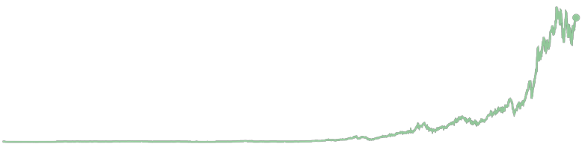






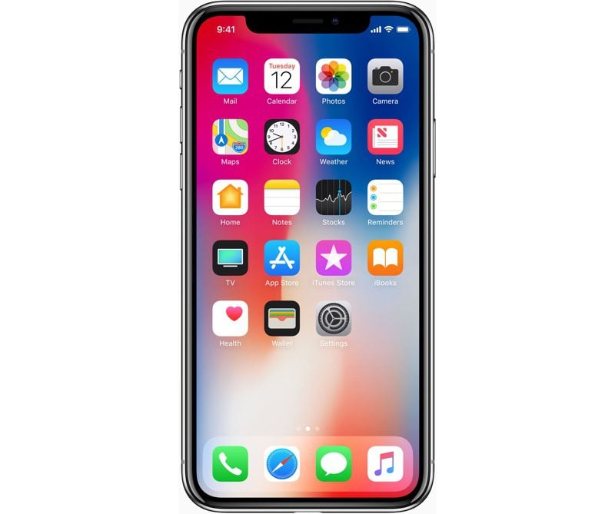
Our Data: Apple – Think Different stock prices from 1980 to 2023
Birth of Macintosh
First iMac released
First iPad released
2017
1997
2007
Tech stock boom
1984
1998
2010
1980
2023
Steve Jobs – CEO again
First iPhone released
iPhone X released
Notes:
So EHF is a vital event for the city of Edmonton and its people because of three key reasons. The experience it provides, the platform it gives and the contributions it’s made to the economy. This is amazing and we want this to continue but we recognize that EHF 2023 is not as smooth sailing

Slide 7
Our Data: Apple – Think Different stock prices from 1980 to 2023
Birth of Macintosh
First iMac released
First iPad released
2017
1997
2007
Tech stock boom
1984
1998
2010
1980
2023
Steve Jobs – CEO again
First iPhone released
iPhone X released
Notes:
So EHF is a vital event for the city of Edmonton and its people because of three key reasons. The experience it provides, the platform it gives and the contributions it’s made to the economy. This is amazing and we want this to continue but we recognize that EHF 2023 is not as smooth sailing

Slide 8
Our Data: Apple – Think Different stock prices from 1980 to 2023
Birth of Macintosh
First iMac released
First iPad released
2017
1997
2007
Tech stock boom
1984
1998
2010
1980
2023
Steve Jobs – CEO again
First iPhone released
iPhone X released
Notes:
So EHF is a vital event for the city of Edmonton and its people because of three key reasons. The experience it provides, the platform it gives and the contributions it’s made to the economy. This is amazing and we want this to continue but we recognize that EHF 2023 is not as smooth sailing

Slide 9
Our Data: Apple – Think Different stock prices from 1980 to 2023
Birth of Macintosh
First iMac released
First iPad released
2017
1997
2007
Tech stock boom
1984
1998
2010
1980
2023
Steve Jobs – CEO again
First iPhone released
iPhone X released
Notes:
So EHF is a vital event for the city of Edmonton and its people because of three key reasons. The experience it provides, the platform it gives and the contributions it’s made to the economy. This is amazing and we want this to continue but we recognize that EHF 2023 is not as smooth sailing

Slide 10
Our Data: Apple – Think Different stock prices from 1980 to 2023
Birth of Macintosh
First iMac released
First iPad released
2017
1997
2007
Tech stock boom
1984
1998
2010
1980
2023
Steve Jobs – CEO again
First iPhone released
iPhone X released
Notes:
So EHF is a vital event for the city of Edmonton and its people because of three key reasons. The experience it provides, the platform it gives and the contributions it’s made to the economy. This is amazing and we want this to continue but we recognize that EHF 2023 is not as smooth sailing

Slide 11







Our Data: Apple – Think Different stock prices from 1980 to 2023
Forefront of technological advancements
High popularity and high volume
Key Reasons for choosing Apple
Birth of Macintosh
1998
1980
2023
1984
1997
2007
2010
2017
Large data point size (over 10,000 rows worth of data)
Seen significant volatility from tech stock boom
Major price changes (71000% all time)
Notes:
So EHF is a vital event for the city of Edmonton and its people because of three key reasons. The experience it provides, the platform it gives and the contributions it’s made to the economy. This is amazing and we want this to continue but we recognize that EHF 2023 is not as smooth sailing

Slide 12
Our Data: Apple – Think Different stock prices from 1980 to 2023
Forefront of technological advancements
High popularity and high volume
Key Reasons for choosing Apple
Birth of Macintosh
1998
1980
2023
1984
1997
2007
2010
2017
Large data point size (over 10,000 rows worth of data)
Seen significant volatility from tech stock boom
Major price changes (71000% all time)
Notes:
So EHF is a vital event for the city of Edmonton and its people because of three key reasons. The experience it provides, the platform it gives and the contributions it’s made to the economy. This is amazing and we want this to continue but we recognize that EHF 2023 is not as smooth sailing

Slide 13
Our Data: Apple – Think Different stock prices from 1980 to 2023
Forefront of technological advancements
High popularity and high volume
Key Reasons for choosing Apple
Birth of Macintosh
1998
1980
2023
1984
1997
2007
2010
2017
Large data point size (over 10,000 rows worth of data)
Seen significant volatility from tech stock boom
Major price changes (71000% all time)
Notes:
So EHF is a vital event for the city of Edmonton and its people because of three key reasons. The experience it provides, the platform it gives and the contributions it’s made to the economy. This is amazing and we want this to continue but we recognize that EHF 2023 is not as smooth sailing

Slide 14
Our Data: Apple – Think Different stock prices from 1980 to 2023
Forefront of technological advancements
High popularity and high volume
Key Reasons for choosing Apple
Birth of Macintosh
1998
1980
2023
1984
1997
2007
2010
2017
Large data point size (over 10,000 rows worth of data)
Seen significant volatility from tech stock boom
Major price changes (71000% all time)
Notes:
So EHF is a vital event for the city of Edmonton and its people because of three key reasons. The experience it provides, the platform it gives and the contributions it’s made to the economy. This is amazing and we want this to continue but we recognize that EHF 2023 is not as smooth sailing

Slide 15
Our Data: Apple – Think Different stock prices from 1980 to 2023
Forefront of technological advancements
High popularity and high volume
Key Reasons for choosing Apple
Birth of Macintosh
1998
1980
2023
1984
1997
2007
2010
2017
Large data point size (over 10,000 rows worth of data)
Seen significant volatility from tech stock boom
Major price changes (71000% all time)
Notes:
So EHF is a vital event for the city of Edmonton and its people because of three key reasons. The experience it provides, the platform it gives and the contributions it’s made to the economy. This is amazing and we want this to continue but we recognize that EHF 2023 is not as smooth sailing

Slide 16
Our Data: Apple – Think Different stock prices from 1980 to 2023
Forefront of technological advancements
High popularity and high volume
Key Reasons for choosing Apple
Birth of Macintosh
1998
1980
2023
1984
1997
2007
2010
2017
Large data point size (over 10,000 rows worth of data)
Seen significant volatility from tech stock boom
Major price changes (71000% all time)
Apple shows significant promise as a dataset that can be further analyzed.
Notes:
So EHF is a vital event for the city of Edmonton and its people because of three key reasons. The experience it provides, the platform it gives and the contributions it’s made to the economy. This is amazing and we want this to continue but we recognize that EHF 2023 is not as smooth sailing

Slide 17
Cleaning and Feature Engineering
Notes:
We will first start off with our data cleaning and feature engineering

Slide 18





Tech Stack: Main libraries and tools used
Data Cleaning
Exploratory Data Analysis
Machine Learning Models
Present your Exploratory Data Analysis and some initial data-driven Insights from the dataset.
You MAY also mention how you are planning to set up the Analysis / ML problem for this case.
You MUST mention how you collected / curated / cleaned / prepared the data for this problem.
Did you only use tools and techniques learned in this course? What ELSE did you learn / try?
Notes:
Our first consideration for identity talks about the growing confusion between EHF and days. This confusion has been around for a while because of K-Days misrepresentation as heritage days. It is further compounded by the fact that both events are happening in the same location, one after the other which only increases confusion. While we recognize this, we must also highlight just how vastly different these two events are. HeritageFest is a celebration of multiculturalism whereas K-Days is an extravaganza with little to no link with multiculturalism. So we need to find ways to differentiate ourselves from K Days. So how do we differentiate ourselves

Slide 19
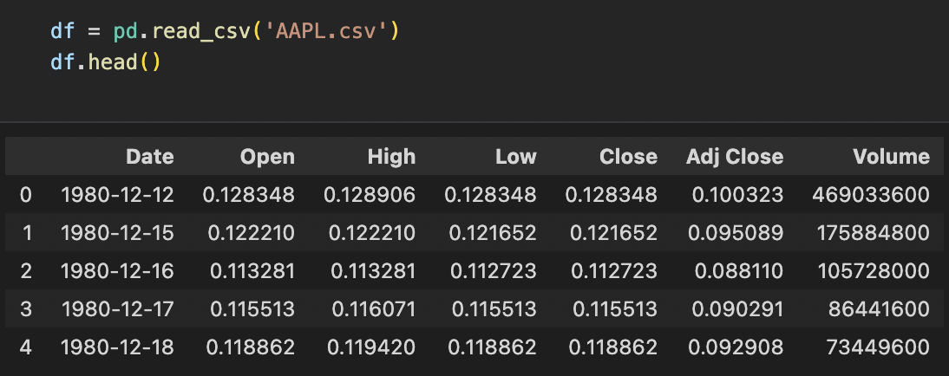

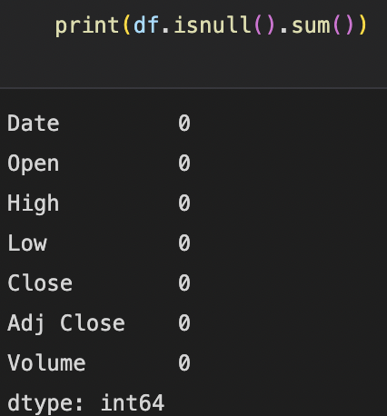
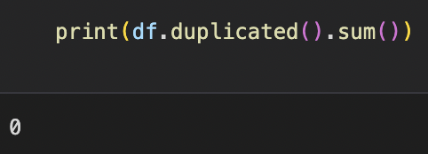
Data Cleaning: Cleaning the dataset to be ready for use
Datasets may contain irrelevant variables that negatively impacts our model
Checking for necessary columns
Therefore, we conduct data cleaning to improve the quality and reliability of the dataset
Removing duplicates and null values from the dataset
For financial time series data that are uncertain and volatile, we considered the necessary information needed for calculating the various technical indicators through…
Present your Exploratory Data Analysis and some initial data-driven Insights from the dataset.
You MAY also mention how you are planning to set up the Analysis / ML problem for this case.
You MUST mention how you collected / curated / cleaned / prepared the data for this problem.
Did you only use tools and techniques learned in this course? What ELSE did you learn / try?
Notes:
Our first consideration for identity talks about the growing confusion between EHF and days. This confusion has been around for a while because of K-Days misrepresentation as heritage days. It is further compounded by the fact that both events are happening in the same location, one after the other which only increases confusion. While we recognize this, we must also highlight just how vastly different these two events are. HeritageFest is a celebration of multiculturalism whereas K-Days is an extravaganza with little to no link with multiculturalism. So we need to find ways to differentiate ourselves from K Days. So how do we differentiate ourselves

Slide 20

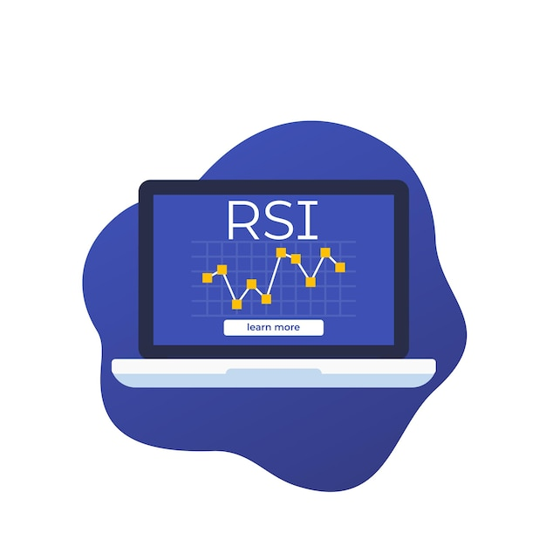
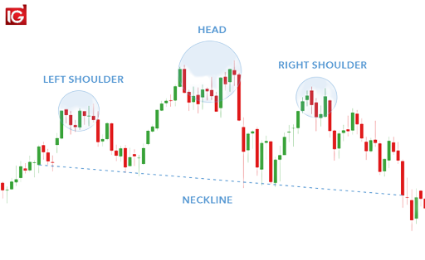
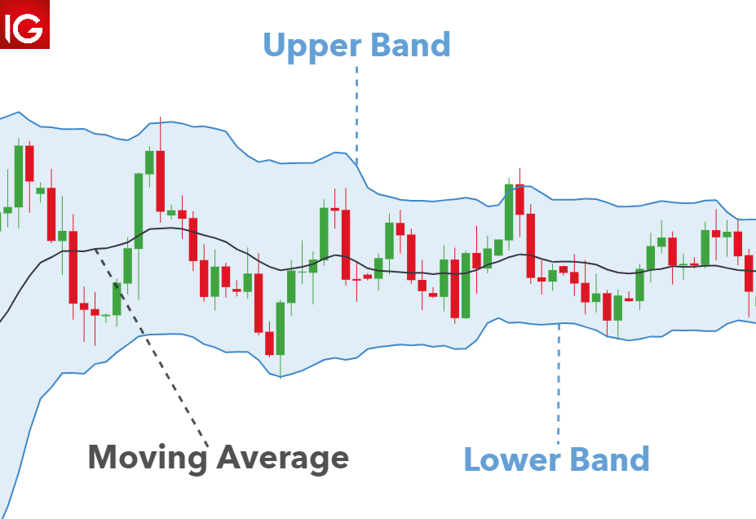
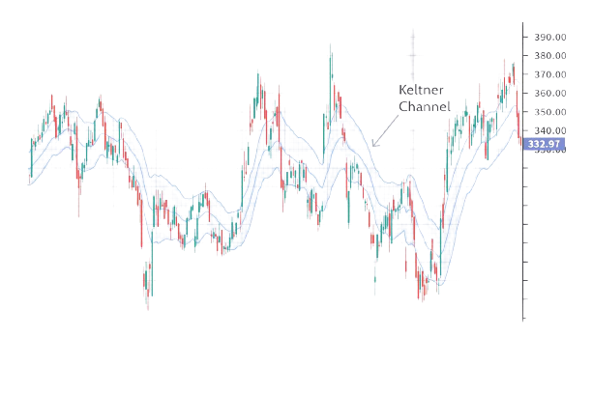
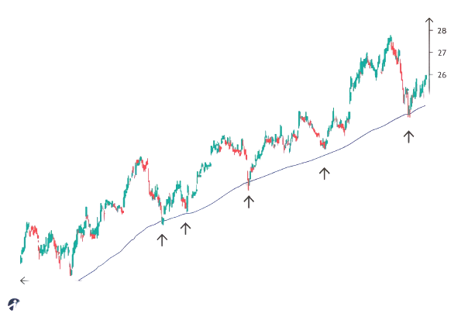

Data Preparation: Preparing the dataset to be used for technical indicators analysis and modelling
Based off our research, we found that the most popular technical indicators used by traders when investing are…
Relative Strength Indicator (RSI)
Heads and Shoulders
Bollinger Bands
Keltner Channels Indicator
Moving Average (MA)
Notes:
Our first consideration for identity talks about the growing confusion between EHF and days. This confusion has been around for a while because of K-Days misrepresentation as heritage days. It is further compounded by the fact that both events are happening in the same location, one after the other which only increases confusion. While we recognize this, we must also highlight just how vastly different these two events are. HeritageFest is a celebration of multiculturalism whereas K-Days is an extravaganza with little to no link with multiculturalism. So we need to find ways to differentiate ourselves from K Days. So how do we differentiate ourselves

Slide 21
Data Preparation: Preparing the dataset to be used for technical indicators analysis and modelling
Based off our research, we found that the most popular technical indicators used by traders when investing are…
Relative Strength Indicator (RSI)
Heads and Shoulders
Bollinger Bands
Keltner Channels Indicator
Moving Average (MA)
Present your Exploratory Data Analysis and some initial data-driven Insights from the dataset.
You MAY also mention how you are planning to set up the Analysis / ML problem for this case.
You MUST mention how you collected / curated / cleaned / prepared the data for this problem.
Did you only use tools and techniques learned in this course? What ELSE did you learn / try?
Notes:
Our first consideration for identity talks about the growing confusion between EHF and days. This confusion has been around for a while because of K-Days misrepresentation as heritage days. It is further compounded by the fact that both events are happening in the same location, one after the other which only increases confusion. While we recognize this, we must also highlight just how vastly different these two events are. HeritageFest is a celebration of multiculturalism whereas K-Days is an extravaganza with little to no link with multiculturalism. So we need to find ways to differentiate ourselves from K Days. So how do we differentiate ourselves

Slide 22
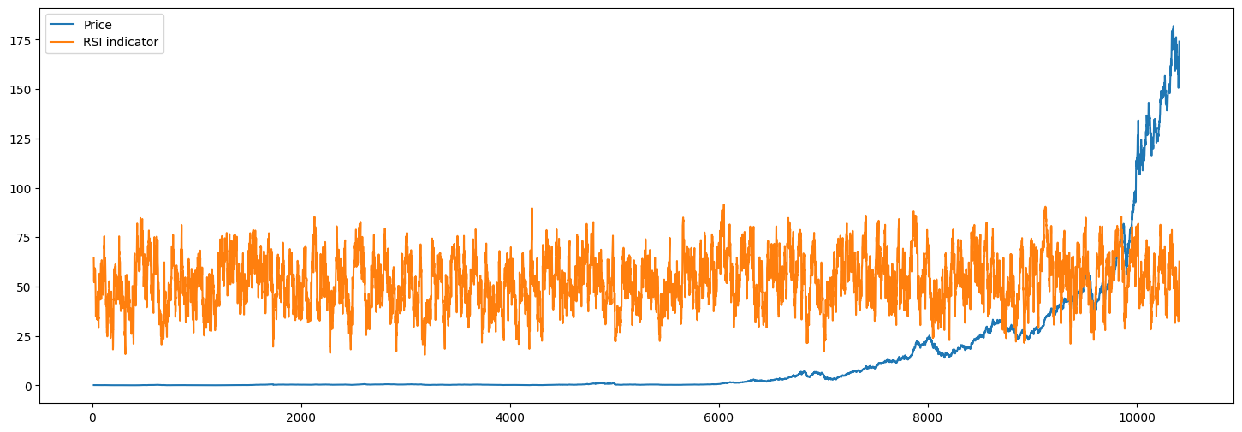
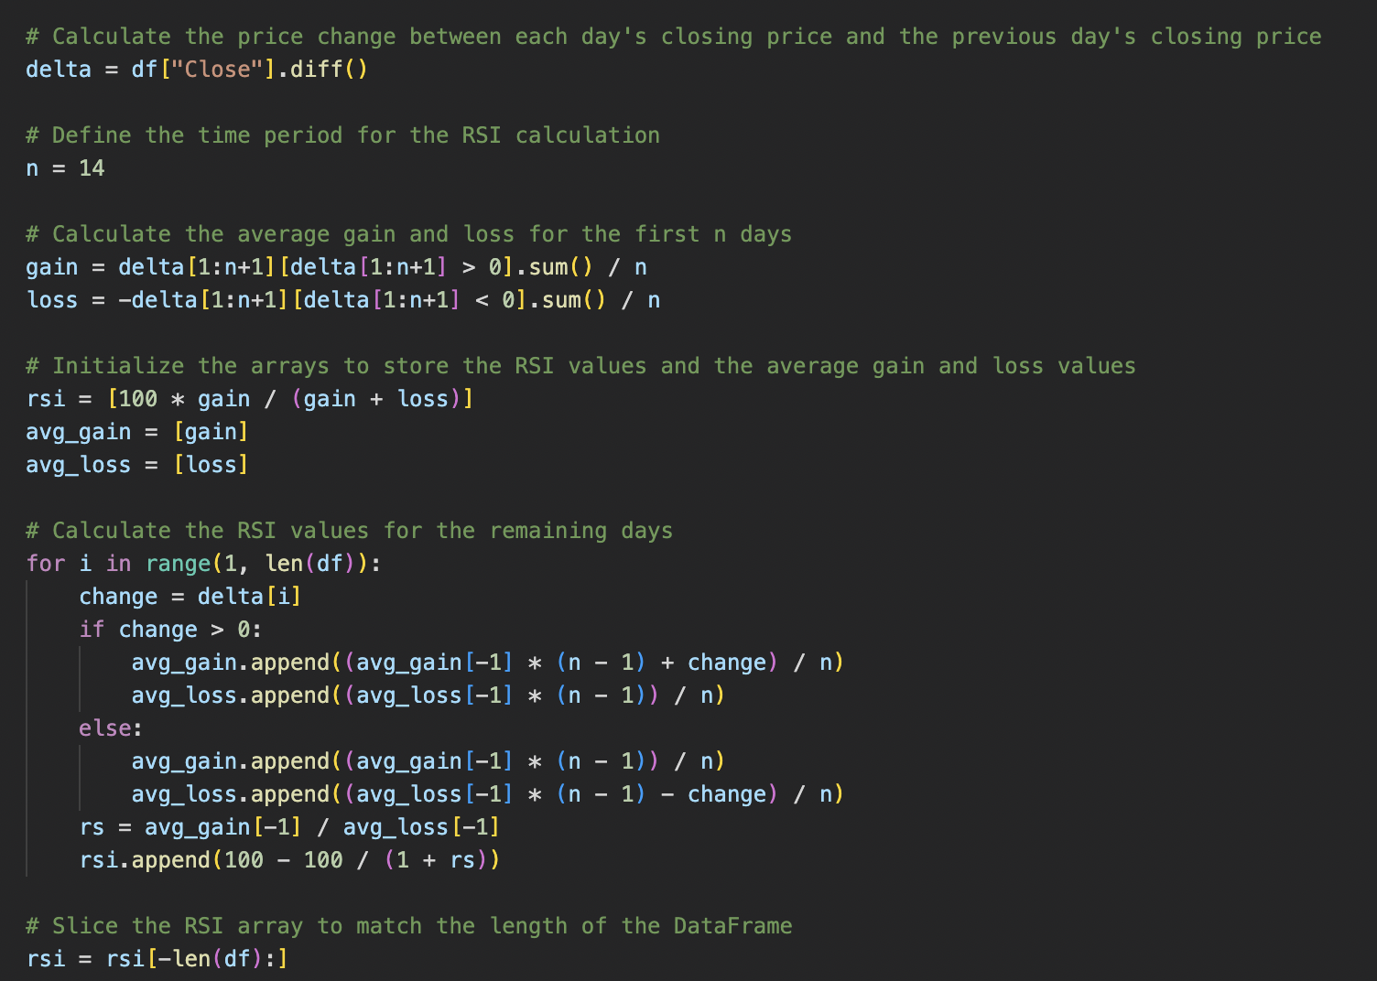
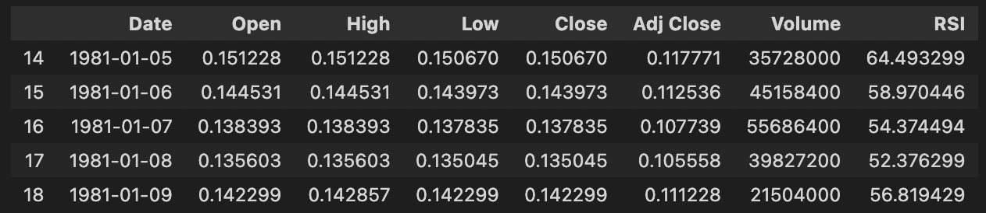
Data Preparation: Preparing the dataset to be used for technical indicators analysis and modelling
Relative Strength Indicator (RSI)
Bollinger Bands
Head and Shoulder
The RSI indicator is a momentum indicator which measures the speed and magnitude of a security’s recent price change.
RSI > 70
indicates that the stocks are overbought and signals the investor that they should consider selling the stocks
RSI < 30
indicates that the stocks are oversold and signals the investor that they should consider buying stocks
Present your Exploratory Data Analysis and some initial data-driven Insights from the dataset.
You MAY also mention how you are planning to set up the Analysis / ML problem for this case.
You MUST mention how you collected / curated / cleaned / prepared the data for this problem.
Did you only use tools and techniques learned in this course? What ELSE did you learn / try?
Notes:
Our first consideration for identity talks about the growing confusion between EHF and days. This confusion has been around for a while because of K-Days misrepresentation as heritage days. It is further compounded by the fact that both events are happening in the same location, one after the other which only increases confusion. While we recognize this, we must also highlight just how vastly different these two events are. HeritageFest is a celebration of multiculturalism whereas K-Days is an extravaganza with little to no link with multiculturalism. So we need to find ways to differentiate ourselves from K Days. So how do we differentiate ourselves

Slide 23
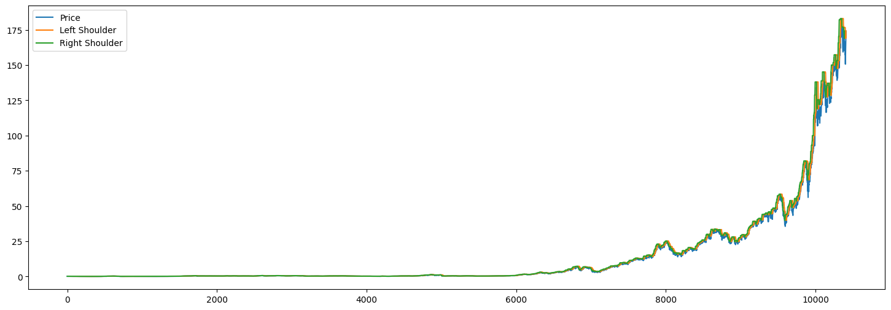
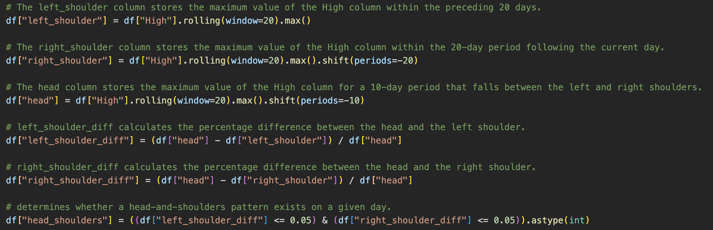
Data Preparation: Calculating the indicators based off the dataset
Head and Shoulder
Relative Strength Indicator (RSI)
Bollinger Bands
Keltner Channel Indicator
Heads and Shoulders indicator has 4 components:
1
Left peak observed first followed by decline
2
Head (highest peak) with 5% distance from both peaks
3
Right peak observed next followed by decline
Neckline is drawn from the two shoulders
Price > Neckline
After the peak of the right shoulder signals the investor that they should consider selling the stocks as the price of stocks are expected to decrease
4
Sources: Investopedia
Present your Exploratory Data Analysis and some initial data-driven Insights from the dataset.
You MAY also mention how you are planning to set up the Analysis / ML problem for this case.
You MUST mention how you collected / curated / cleaned / prepared the data for this problem.
Did you only use tools and techniques learned in this course? What ELSE did you learn / try?
Notes:
Our first consideration for identity talks about the growing confusion between EHF and days. This confusion has been around for a while because of K-Days misrepresentation as heritage days. It is further compounded by the fact that both events are happening in the same location, one after the other which only increases confusion. While we recognize this, we must also highlight just how vastly different these two events are. HeritageFest is a celebration of multiculturalism whereas K-Days is an extravaganza with little to no link with multiculturalism. So we need to find ways to differentiate ourselves from K Days. So how do we differentiate ourselves

Slide 24
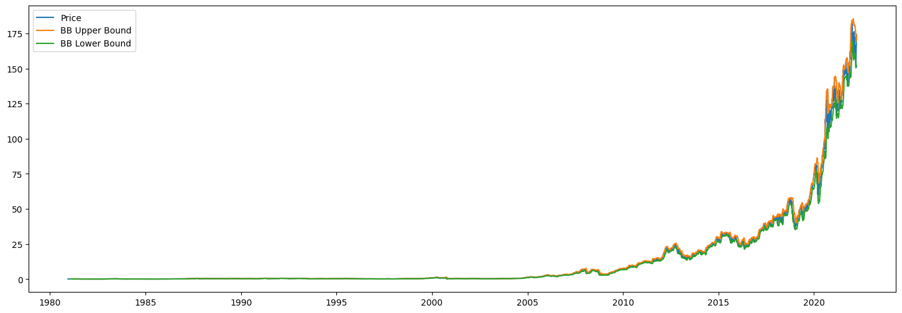
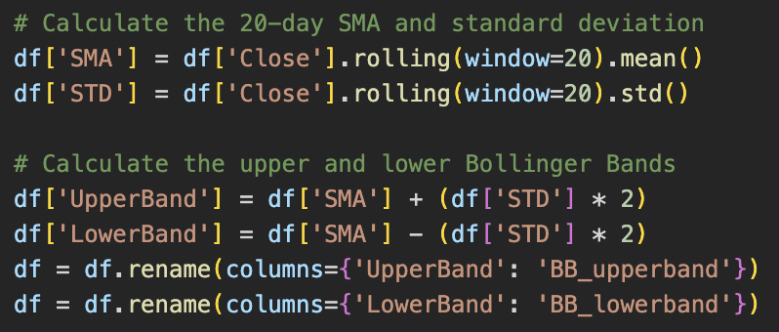
Data Preparation: Calculating the indicators based off the dataset
Bollinger Bands
Head and Shoulder
Keltner Channel Indicator
Moving Average Indicator (MA)
BB is used to determine overbought & oversold conditions
1
A 20-day sampling moving average is used for the middle band
2
Upper Bound is calculated by taking middle band and adding twice the daily standard deviation
Price > Upper Bound
Indicates that the market is overbought and signals the investor that they should consider selling the stocks as it is due to pullback soon
3
Lower Bound is calculated by taking middle band and subtracting twice the daily standard deviation
Price < Lower Bound
Indicates that the market is oversold and signals the investor that they should consider buying stocks as it is due to bounce soon
Sources: Investopedia
Present your Exploratory Data Analysis and some initial data-driven Insights from the dataset.
You MAY also mention how you are planning to set up the Analysis / ML problem for this case.
You MUST mention how you collected / curated / cleaned / prepared the data for this problem.
Did you only use tools and techniques learned in this course? What ELSE did you learn / try?
Notes:
Our first consideration for identity talks about the growing confusion between EHF and days. This confusion has been around for a while because of K-Days misrepresentation as heritage days. It is further compounded by the fact that both events are happening in the same location, one after the other which only increases confusion. While we recognize this, we must also highlight just how vastly different these two events are. HeritageFest is a celebration of multiculturalism whereas K-Days is an extravaganza with little to no link with multiculturalism. So we need to find ways to differentiate ourselves from K Days. So how do we differentiate ourselves

Slide 25
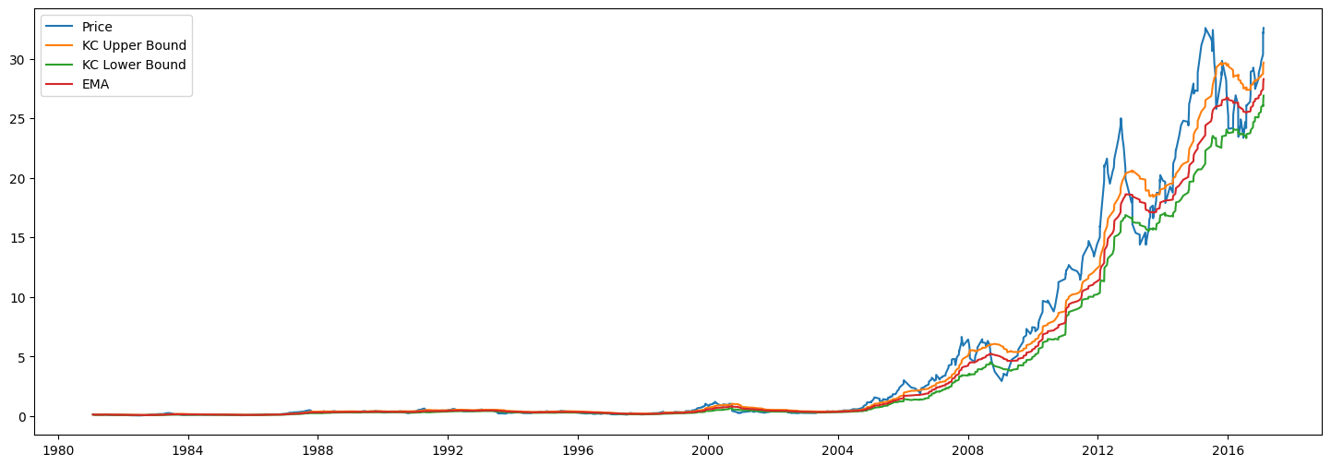
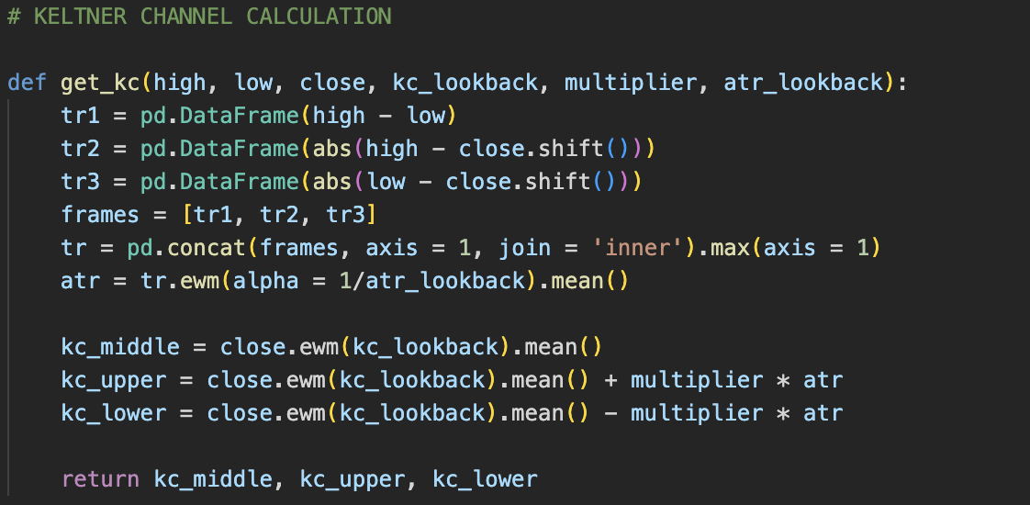
Data Preparation: Calculating the indicators based off the dataset
Keltner Channel Indicator
Bollinger Bands
Moving Average Indicator (MA)
KC are volatility-based bands and aids in determining the direction of a trend
1
A 20-day exponential moving average is used for the middle band
2
Upper Bound is calculated by taking middle band and adding twice the average true range (ATR)
Price > Upper Bound
Indicates price strength and signals the investor that they should consider selling the stocks as it is due to pullback soon
3
Lower Bound is calculated by taking middle band and subtracting twice the average true range (ATR)
Price < Lower Bound
Indicates price weakness and signals the investor that they should consider buying stocks as there is evidence of a downtrend
Sources: Investopedia
Present your Exploratory Data Analysis and some initial data-driven Insights from the dataset.
You MAY also mention how you are planning to set up the Analysis / ML problem for this case.
You MUST mention how you collected / curated / cleaned / prepared the data for this problem.
Did you only use tools and techniques learned in this course? What ELSE did you learn / try?
Notes:
Our first consideration for identity talks about the growing confusion between EHF and days. This confusion has been around for a while because of K-Days misrepresentation as heritage days. It is further compounded by the fact that both events are happening in the same location, one after the other which only increases confusion. While we recognize this, we must also highlight just how vastly different these two events are. HeritageFest is a celebration of multiculturalism whereas K-Days is an extravaganza with little to no link with multiculturalism. So we need to find ways to differentiate ourselves from K Days. So how do we differentiate ourselves

Slide 26
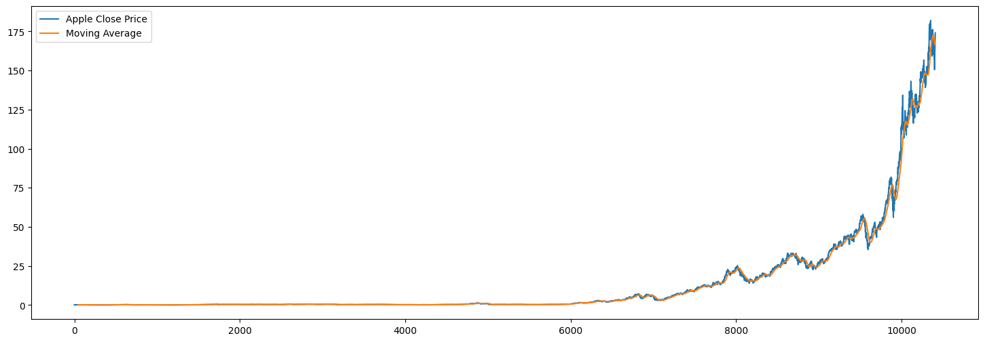
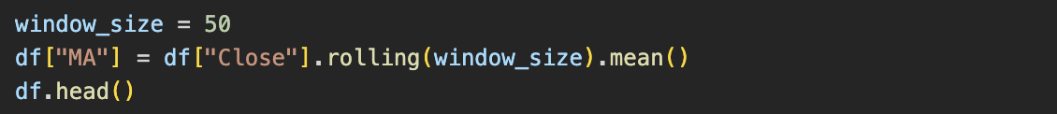
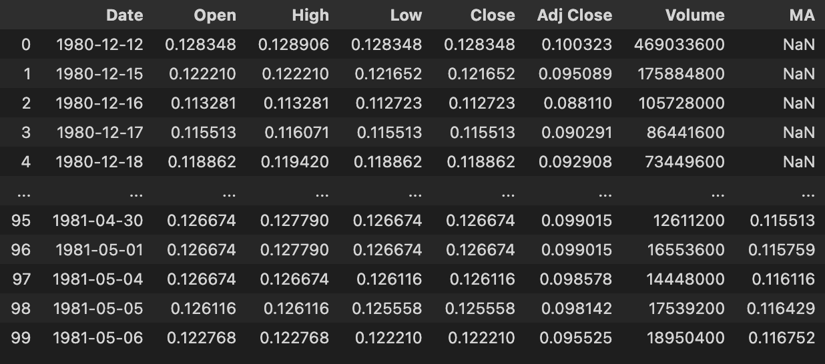
Data Preparation: Calculating the indicators based off the dataset
Moving Average Indicator (MA)
Keltner Channel Indicator
MA smooths out price data by creating a constantly updated average price. We used a period of 50 days to observe long-term price trends.
Price > MA
Indicates that the price trend is expected go upwards and investors can consider selling
Price < MA
Indicates that the price trend is expected go downwards and investors can consider buying
Sources: Investopedia
Notes:
Our first consideration for identity talks about the growing confusion between EHF and days. This confusion has been around for a while because of K-Days misrepresentation as heritage days. It is further compounded by the fact that both events are happening in the same location, one after the other which only increases confusion. While we recognize this, we must also highlight just how vastly different these two events are. HeritageFest is a celebration of multiculturalism whereas K-Days is an extravaganza with little to no link with multiculturalism. So we need to find ways to differentiate ourselves from K Days. So how do we differentiate ourselves

Slide 27
EDA & Visualization
Notes:
We will first start off with our analysis

Slide 28
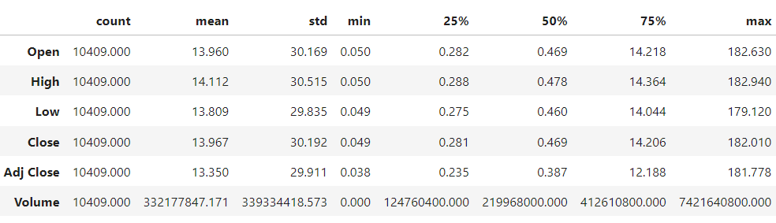
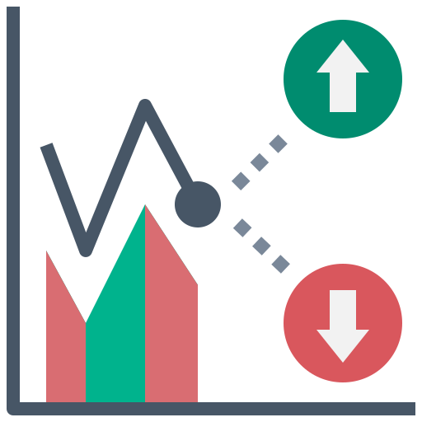

Statistical Analysis
Description of the Apple Stock Price Dataset
Volatility
Skewness of Data
A higher standard deviation indicates volatility. AAPL standard deviation aligns with the typical standard deviation seen for large-cap stocks
(Mean – Median) tells us the skewness of data. Positive difference means positive skewness while negative difference means negative skewness.

Slide 29
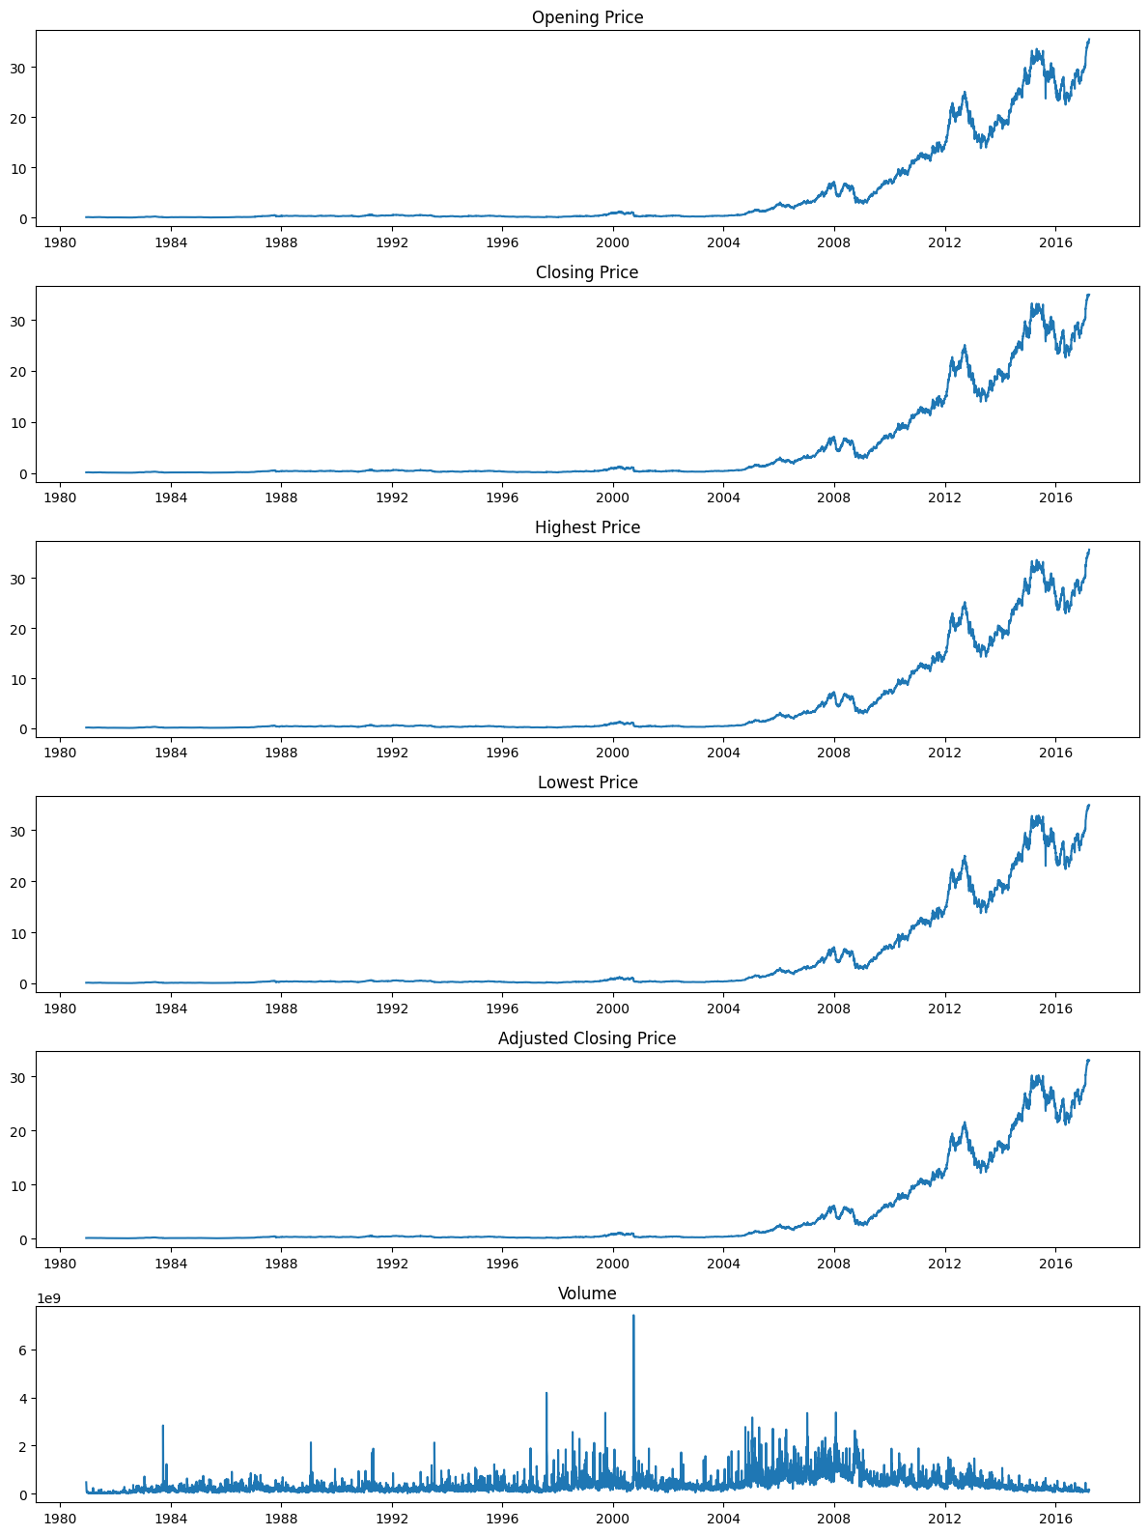
Time Series Analysis: General increasing trend in Opening Price and Closing Price
Opening & Closing Price
Highest & Lowest Price
From the time series analysis, we can observe that there are peaks in 2013, and in 2015. The data shows a further increasing trend after 2016 as well.

Slide 30
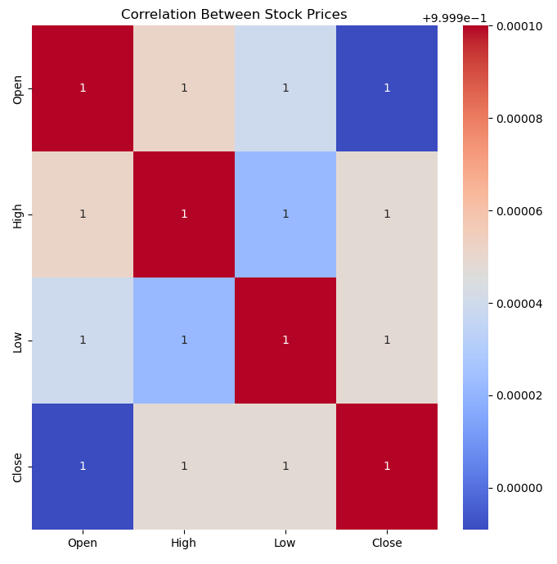
Correlation Analysis
Correlation Heat Map
R ≈ 1. Tells us that all the variables are strongly correlated to each other. This correlation indicates that a high opening price would indicate a typically high closing price as well.
This information would be particularly useful for day-traders looking to make multiple trades within the day itself
It is important to note that this data cannot be closely followed as correlation does not imply causation.

Slide 31
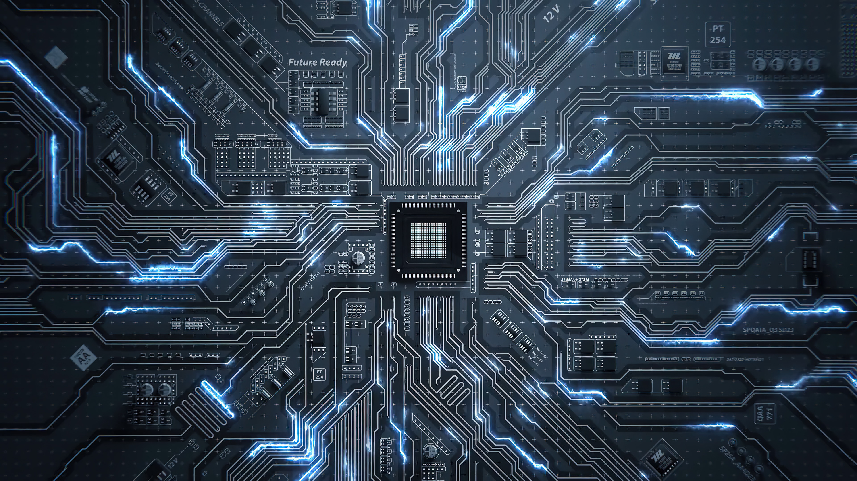
Machine Learning
Notes:
We will first start off with our analysis

Slide 32
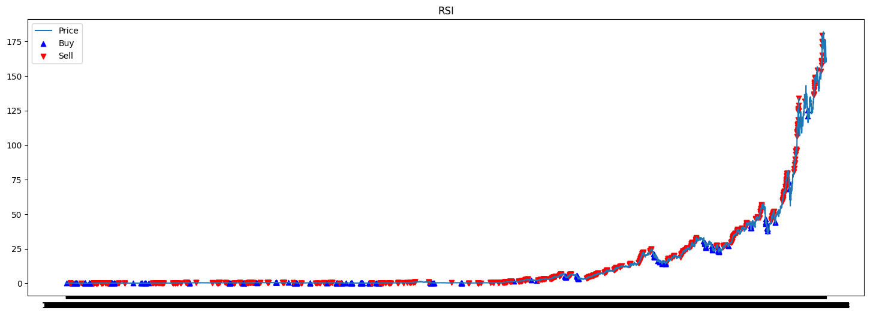
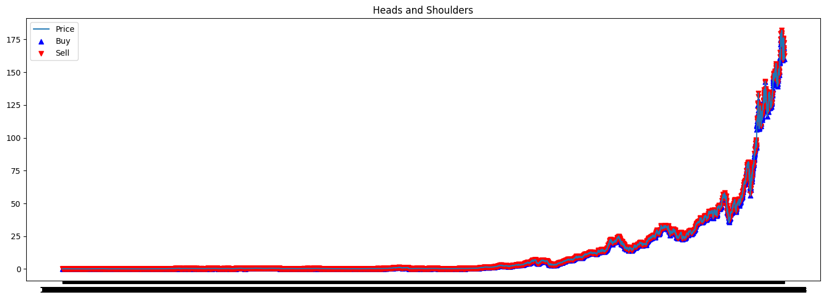
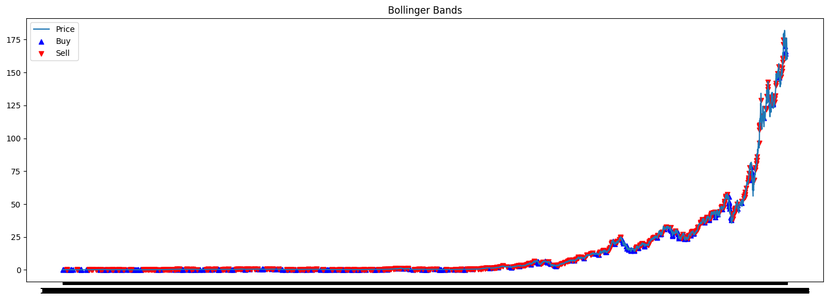
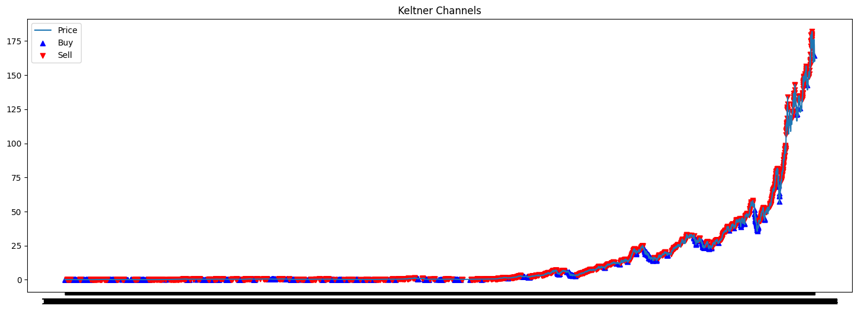
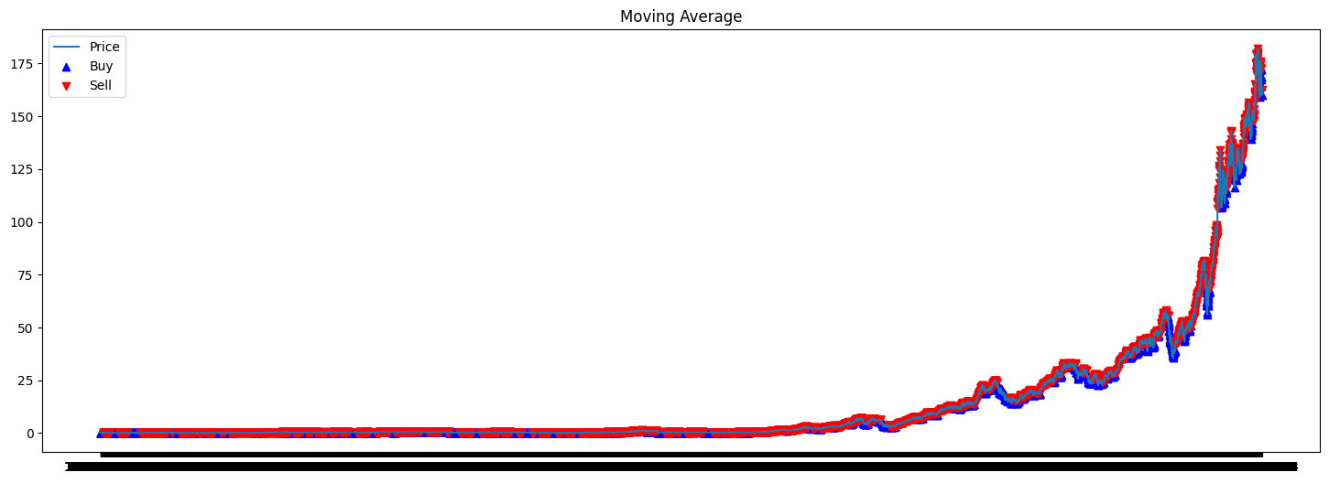
Regression Models: We trained the data for each indicator and predicted the closing price based on the test data to find the accuracy of prediction
Moreover, we evaluated the relative indicators and signaled when the investor should buy or sell his/her stocks
Accuracy: 0.5151515151515151
Accuracy: 0.536428110896196
Accuracy: 0.5148291424887169
Relative Strength Indicator (RSI)
Heads and Shoulders
Bollinger Bands
Accuracy: 0.5012894906511928
Accuracy: 0.5041908446163765
Keltner Channels Indicator
Moving Average (MA)

Slide 33
Regression Models: We trained the data for each indicator and predicted the closing price based on the test data to find the accuracy of prediction
Moreover, we evaluated the relative indicators and signaled when the investor should buy or sell his/her stocks
We found that the accuracy of each indicator ranges from 50% – 54%, which shows a low chance of investors obtaining high returns and hence, is a poor prediction tool.
But can we do better?
Accuracy: 0.5151515151515151
Accuracy: 0.536428110896196
Accuracy: 0.5148291424887169
Relative Strength Indicator (RSI)
Heads and Shoulders
Bollinger Bands
Accuracy: 0.5012894906511928
Accuracy: 0.5041908446163765
Keltner Channels Indicator
Moving Average (MA)

Slide 34

Using a combination of technical indicators together may be able to better predict price action
By taking in the different indicators to predict market conditions and price movement...
Relative Strength Contributor (RSI)
Heads and Shoulders
Highlighting the strengths and eliminating the uncertainties of each indicator increases the accuracy of price movement prediction
Bollinger Bands
Keltner Channels
Moving Average
If you used ML (regression, classification, or something else); mention mainly WHICH one(s).
You may now briefly CLARIFY why and how the ML problem(s) aim(s) to solve your objective.
How did you apply ML technique(s) to SOLVE your problem? Which model(s), how and why?
Did you only use tools and techniques learned in this course? What ELSE did you learn / try?

Slide 35

There is a vast sea of ML models that can potentially be chosen
Linear Regression
XGBoost
LightGBM
Naive Bayes
Convolutional NN
Principal CA
Gaussian MM
Logistic Regression
Gradient Boosting
CatBoost
K-Nearest Neighbors
Recurrent NN
Factorization Machine
Hidden Markov
Decision Tree
Random Forest
Support Vector
Artificial NN
Auto
Encoder
Adaboost
Hierarchical Clustering

Slide 36
There is a vast sea of ML models that can potentially be chosen
Linear Regression
XGBoost
LightGBM
Naive Bayes
Convolutional NN
Principal CA
Gaussian MM
K-Nearest Neighbors
Recurrent NN
Factorization Machine
Hidden Markov
Gradient Boosting
CatBoost
Logistic Regression
Artificial NN
Auto
Encoder
Adaboost
Hierarchical Clustering
Decision Tree
Support Vector
Random Forest

Slide 37
There is a vast sea of ML models that can potentially be chosen
Naive Bayes
Gaussian MM
Linear Regression
XGBoost
LightGBM
Convolutional NN
Logistic Regression
Gradient Boosting
CatBoost
Principal CA
Artificial NN
Decision Tree
Random Forest
Support Vector
Recurrent NN
Hidden Markov
Factorization Machine
K-Nearest Neighbors
Auto
Encoder
Adaboost
Hierarchical Clustering

Slide 38
There is a vast sea of ML models that can potentially be chosen
Linear Regression
XGBoost
LightGBM
Naive Bayes
Convolutional NN
Principal CA
Gaussian MM
Logistic Regression
Gradient Boosting
CatBoost
K-Nearest Neighbors
Recurrent NN
Factorization Machine
Hidden Markov
Decision Tree
Random Forest
Support Vector
Artificial NN
Auto
Encoder
Adaboost
Hierarchical Clustering

Slide 39
There is a vast sea of ML models that can potentially be chosen
Linear Regression
XGBoost
LightGBM
Naive Bayes
Convolutional NN
Principal CA
Gaussian MM
Logistic Regression
Gradient Boosting
CatBoost
K-Nearest Neighbors
Recurrent NN
Factorization Machine
Hidden Markov
Decision Tree
Random Forest
Support Vector
Artificial NN
Auto
Encoder
Adaboost
Hierarchical Clustering

Slide 40





We primarily tested four key ML models chosen based on available resources and relevance to decisions
Key features of data
ML models chosen
Technical Indicators are often noisy, may not have direct and linear relationship
Logistics Regression: useful for binary classification by fitting logistics regression equation
Model must handle nonlinearity and learn complex relationships
Decision Tree: partition the data into smaller groups and improve predictive accuracy
Model must handle high-dimensional input spaces and handle outliers
XGBoost: tree-based model using gradient boosting to optimize objective functions
Multiple indicators need to be used together in predicting future price action
Support Vector Machine: find optimal hyperplane to split data into different classes

Slide 41
How did we apply these ML models solve the problem?
Logistic Regression
Decision Tree
A supervised learning model that predicts the probability of price movement (up/down) occurring
A supervised learning model using various checkpoints on the technical indicators
A price movement graph where up = 1 and down = 0 is predicted from the technical indicators
Fitted with hyperparameters to increase accuracy, the model identifies the most powerful indicator and quantifies the strength and direction of these relationships
XGBoost
Support Vector Machine (SVM)
A supervised learning model that handles complex and non-linear relationships between indicators and future price
A supervised model that finds a hyperplane that best separates indicators into different classes for future price movements
Fitted with hyperparameters to increase accuracy, XGBoost handles missing data, feature selection and feature engineering.
Fitted with hyperparameters to increase accuracy, SVM predicts the classes of future price movements based on the technical indicators
These ML Models helps investors make informed decisions by solving the uncertainty around technical indicators
Accuracy: 0.5151515151515151
Accuracy: 0.536428110896196
Accuracy: 0.5148291424887169
Relative Strength Indicator (RSI)
Heads and Shoulders
Bollinger Bands
Accuracy: 0.5012894906511928
Accuracy: 0.5041908446163765
Keltner Channels Indicator
Moving Average (MA)

Slide 42




We primarily tested four key ML models chosen based on available resources and relevance to decisions
Accuracies of Individual Technical Indicators
Accuracies of Multiple Technical Indicators
Combining Indicators
Using complex ML Models
Improving accuracy with hyper tuning
Bollinger Bands
0.527
Logistics Regression
0.591
Heads and Shoulders
0.590
Random Forest
0.612
Relative Strength Indicator (RSI)
0.611
XGBoost
0.612
Keltner Channels Indicator
0.527
Support Vector Machine
0.568
Moving Average (MA)
0.527
Accuracy: 0.5151515151515151
Accuracy: 0.536428110896196
Accuracy: 0.5148291424887169
Relative Strength Indicator (RSI)
Heads and Shoulders
Bollinger Bands
Accuracy: 0.5012894906511928
Accuracy: 0.5041908446163765
Keltner Channels Indicator
Moving Average (MA)

Slide 43
We primarily tested four key ML models chosen based on available resources and relevance to decisions
Accuracies of Individual Technical Indicators
Accuracies of Multiple Technical Indicators
Combining Indicators
Using complex ML Models
Improving accuracy with hyper tuning
Bollinger Bands
0.527
Logistics Regression
0.591
Similar to our hypothesis, using a combination of technical indicators is better in predicting future price action, however this improvement is marginal in nature.
Heads and Shoulders
0.584
Random Forest
0.612
Relative Strength Indicator (RSI)
0.486
XGBoost
0.612
Keltner Channels Indicator
0.528
Support Vector Machine
0.568
Moving Average (MA)
0.527
Accuracy: 0.5151515151515151
Accuracy: 0.536428110896196
Accuracy: 0.5148291424887169
Relative Strength Indicator (RSI)
Heads and Shoulders
Bollinger Bands
Accuracy: 0.5012894906511928
Accuracy: 0.5041908446163765
Keltner Channels Indicator
Moving Average (MA)

Slide 44
However, investing should never be done purely relying on technical indicators
Evaluation of our ML Models
Logistic Regression
Random Forest
XGBoost
Support Vector Machine
Accuracy: 59.1%
Accuracy: 61.2%
Accuracy: 61.2%
Accuracy: 56.8%
SVM has the lowest accuracy, due to its nature. Stocks are considered noisy data, hence SVM will have difficulties finding the optimal hyperplane
XGBoost has the highest accuracy, because it uses a gradient boosting technique which learns from weak models to create a stronger model
The predictive accuracy of using a combination of indicators is still relatively low and cannot be entirely trusted to make decisions for buying and selling stocks

Slide 45
Conclusion
Notes:
We will first start off with our analysis

Slide 46



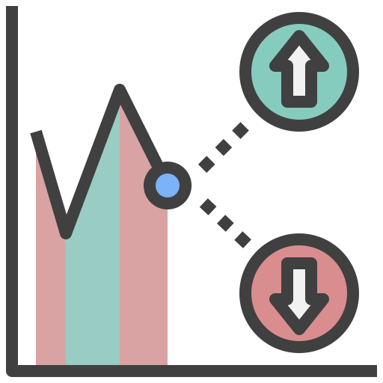
How can we provide more insightful recommendations to investors on the right time to buy and sell stocks?
Problem Statement: Are technical indicators accurate in predicting future price action? Can a combination of indicators improve this accuracy?
Short Answer: No, the accuracy is considered rather low (average = 55%). This accuracy improves to marginally by using multiple indicators (average = 60%).
Accuracies of individual indicators are low and are not reliable to be used alone
Investors should use multiple indicators to predict the price movement and utilise the signals from them to buy/sell stocks
Indicators are not fool-proof and investors should still practice caution while using them
XGBoost model had the highest accuracy in using multiple indicators to predict future price movement
What is the OUTCOME of your project? Did it solve your original problem? Anything interesting?
What are your data-driven INSIGHTS and recommendations / views towards the target problem?

Slide 47
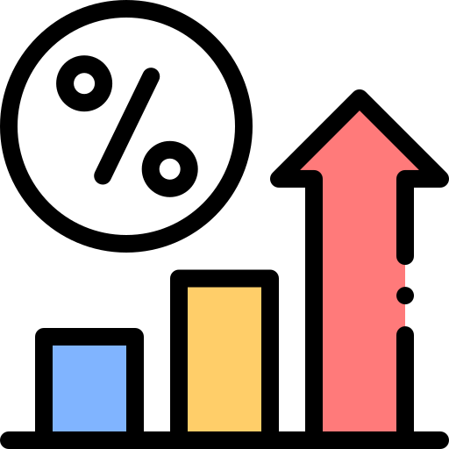

Conclusion & Final Thoughts
Conclusions
Challenges faced while evaluating models
Mitigations
Areas for future exploration
1
Significant disparities between prices in the early 1980s & the late 2010s, which could have affected predictions
Testing multiple test/train splits to obtain a better representation for training
Running more complex algorithms to obtain the optimal split
2
The data quality is low as financial time series data are noisy, affecting predictions
Feature Engineering by choosing the best indicators and hyperparameter testing.
Performing higher level ML models with more computation
Outcome
While using multiple indicators to predict future price movement is somewhat better than using single indicators, it is still lacking in its effectiveness to accurately do so. Therefore, investors should use these indicators cautiously.
What is the OUTCOME of your project? Did it solve your original problem? Anything interesting?
What are your data-driven INSIGHTS and recommendations / views towards the target problem?

